Slide 1
Data 607, Final Project: Suicide Rates of US States: Why Are They So Different?
By Mikhail Groysman, 12/10/2018

Slide 2
Motivation: 4.5 Times Difference
Because of suicide, US Life Expectancy is dropping
Suicide rate is going up for 2 decades
Suicide rates vary widely across the states
6.6 – DC vs 28.9 – Montana, 4.5 times difference
Suicides in the news all the time
Need to understand why the state rates are so different

Slide 3
Current Knowledge – Suicides Drivers
Gender
Age
Mental Health
Substance Abuse
Availability of guns
Ethnicity

Slide 4
Data Sources – 3 Sources
CDC Wonder – Federal Mortality DB
SAMHA State Survey of MH and SA
Wikipedia – Suicide Rates by Country

Slide 5
US States vs World Countries – Top 5!
Rank | Country | US State Ind | Age Adj Rate
1 | Guyana | N | 30.200
2 | Montana | Yes | 28.943
3 | Lesotho | N | 28.900
4 | Alaska | Yes | 27.014
5 | Wyoming | Yes | 26.940
6 | Russia | N | 26.500
7 | Lithuania | N | 25.700
8 | New Mexico | Yes | 23.300
9 | Suriname | N | 23.200
10 | Idaho | Yes | 23.168

Slide 6
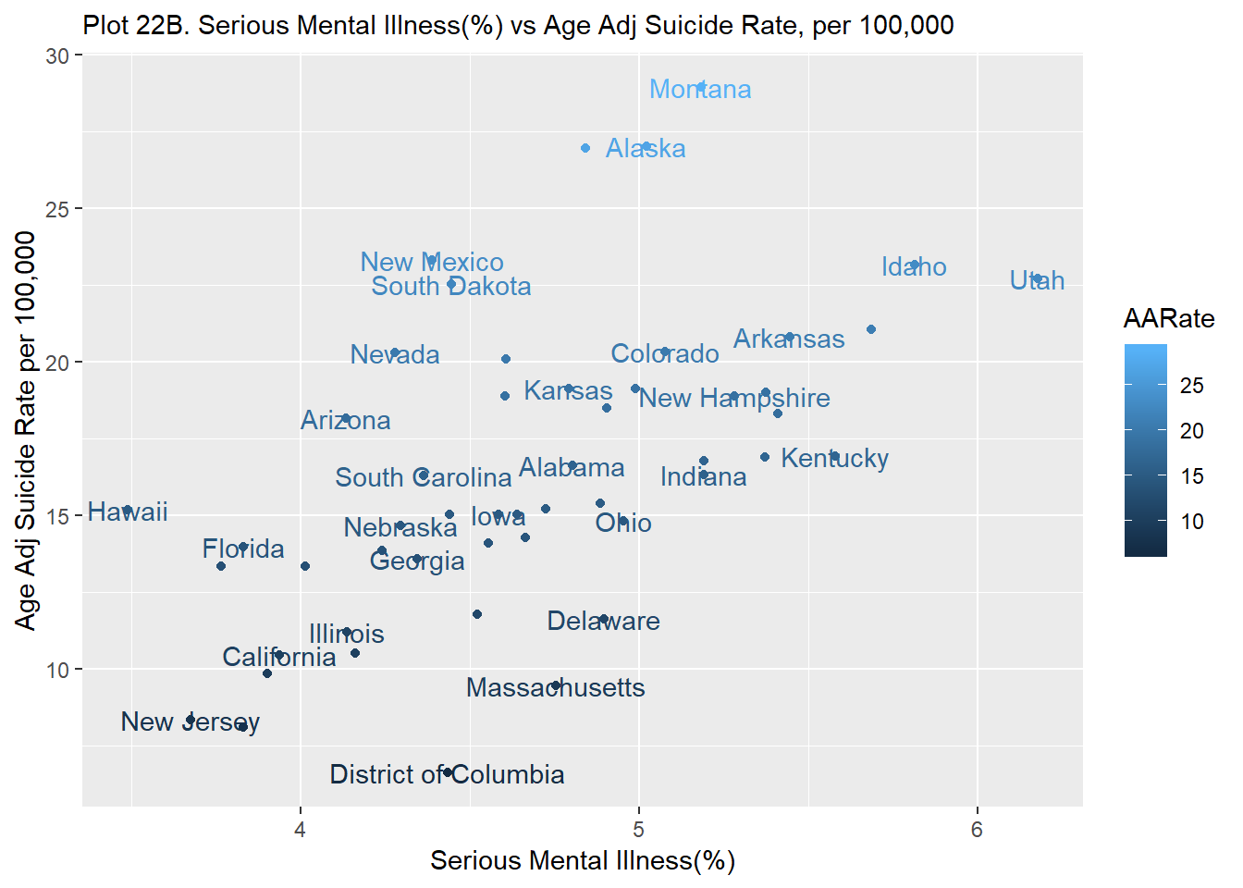
Mental Illness vs Suicide Rate: r=0.57, Utah, and Montana

Slide 7
Conclusions – Some success
Painkiller Abuse correlates moderately with suicides. Painkiller abuse continues to spread and it will negatively effect suicide rate in future.
Male and female suicide rates by state strongly correlate, so it is possible that drivers behind suicides for both genders are the same. Male suicide rates have much more variance to them vs females.
Attempt to create Linear Model of Serious Thoughts of Suicide was not very successful. R squire was only 0.72. The variables were Serious Mental Illness, Painkiller Abuse Disorder, and Drug Use, Any Drug. We need additional variables.
Clustering states based on SAMHSA survey allowed to cluster states into 4 different groups, however these groups would not correspond to state suicide rates well.
Comparing high suicide state (Colorado) and low suicide state (Minnesota) indicates alcohol, drugs, and violence as culprits.
DC vs Montana. 3 drivers - very high suicide rate among Montana Native American population, rural/small metro environment in Montana, and high gun ownership and correspondingly high gun suicide rate in Montana.

Slide 8
Recommendations – More Work Needed
Create centralized public database for suicide data.
Create methods of improved data collection related to suicide.
Try to understand how other countries were able to lower their suicide rates. For example, Japan had a lot of success.
More research into connection between mental illness, alcohol, drugs, violence, gun ownership, and suicide.
To see if success of low suicide states could be applied to high suicide states.
More research into how people go from thinking to actually commuting suicide.

